Slide 1
DATA STRUCTURES
Operations of LinkedList

Slide 2
Operations in the List
Create list
Inserting element at the front
Inserting element at the end
Insertion of an element in the list
Given element
Display
Find
Delete
Check whether the list is empty
Check whether the list has only one element

Slide 3






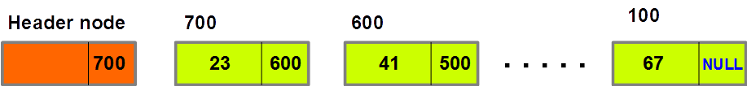
Creation of List – Insert node at the front

Slide 4

Creation of List – Insert node at the end

Slide 5


Creation of List - Implementation
How do you create a node?
struct node
{
int data
struct node *next
}
How do you create header?
struct node *header
header=malloc(sizeof(struct node*))
header->next=NULL

Slide 6
Algorithm– Insertion of node at the front
//Algorithm for Insertion of data at the front
void insertFront(struct node* header,
int x)
{ //create data node
struct node *temp temp=malloc(sizeof(struct node*)) temp->data=x
//Adjust pointers
header->next=temp
temp->next=NULL }
//Calling insertFront procedure
insertFront(header,87) print(header->next->data)

Slide 7

Displaying the list

Slide 8
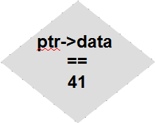
Insertion – before the given element
Element to be inserted = 66
Needs to be inserted v=before 41

Slide 9
Summary
Creation of List
Display the elements in the list

Slide 10
Simple Questions
How do you iterate the elements in the list?
How do you allocate memory for the node data structure?
Can I use display routine and modify it to search an element in the list?

Slide 11
In the class
We will write routine for the following:
Complete insertFront function
Insert an element in the middle of the list
Display the elements in the list
Find an element in the list

